Slide 1



DEPARTMENT OF COMPUTER SCIENCE & ENGINEERING
Domain Winter Winning Camp 2023
Subject Name: Database Management System
Day: 6
Topics Covered:
Introduction to Key and Functional dependencies and Normalization
DISCOVER . LEARN . EMPOWER
‹#›

Slide 2
Content
Formal definition of keys
Various types of keys
Functional dependencies
Normal Forms
‹#›

Slide 3
Prerequisite of Topic: Basic Knowledge of keys
Objective: To be able to understand functional dependencies, first, second, third, fourth, fifth and DKNF.
Outcome: Student will be able to design normalized database.

Slide 4
Why we have Keys in DB?
• A Key is an attribute or a set of attributes in a relation that identifies a tuple (record) in a relation.
• The keys are defined in a table to access or sequence the stored data quickly and smoothly.
• They are also used to create relationship between different tables

Slide 5
Types of Keys in Database
1. Primary Key
2. Candidate Key
3. Alternate Key
4. Super Key
5. Composite Key
6. Foreign Key
7. Unique Key

Slide 6
Primary Key (PK)
• Which is Unique & Can’ t be have NULL Value
• Is the column you choose to maintain uniqueness in a table at row level.
• Here in Employee table we can choose either Employee ID or SSN column for a PK.
• EmployeeID is preferable choice because SSN is a secure (PII) value.
• Primary key is the minimal super keys. In the ER diagram primary key is represented by underlining the primary key attribute.
• Ideally a primary key is composed of only a single attribute.
• But it is possible to have a primary key composed of more than one attribute

Slide 7
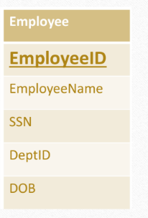
Primary Key (PK)

Slide 8
To define a field as primary key, following conditions had to be met :
• No two rows can have the same primary key value.
• Every row must have a primary key value.
• The primary key field cannot be null.
• Value in a primary key column can never be modified or updated, if any foreign key refers to that primary key

Slide 9
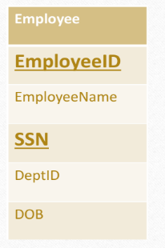
Candidate Key
• Are individual columns in a table that qualifies for uniqueness of each row/tuple.
• Here in Employee table EmployeeID & SSN are eligible for a Primary Key and thus are Candidate keys.
• Candidate Keys are super keys for which no proper subset is a super key.
In other words candidate keys are
minimal super keys.

Slide 10
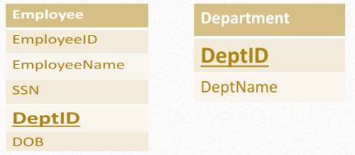
Foreign Key
• Here in below tables DeptID of Department table is Primary Key where as DeptID of Employee is an Foreign key.
• It means it has referred to another table. This concept is also known as Referential Integrity.

Slide 11
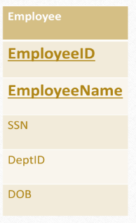
Super Key
• If you add any other Column /Attribute to a Primary Key then it become a Super Key, like EmployeeID + EmployeeName is a Super Key.
• Super key stands for superset of a key.
• A Super Key is a set of one or more attributes that are taken collectively and can identify all other attributes uniquely.

Slide 12
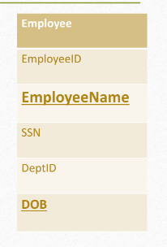
Composite Key
• If a table do have a single column that qualifies for a Candidate key, then you have to select 2 or more columns to make a row
Unique.
• Like if there is no Employee ID or SSN columns, then you can make EmployeeName + Date Of Birth (DOB) as Composite Key.
But still there can be a narrow chance of duplicate rows.

Slide 13
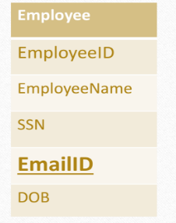
Unique Key
• Unique key is same as primary with the difference being the existence of null.
• Unique key field allows one value as NULL value.

Slide 14
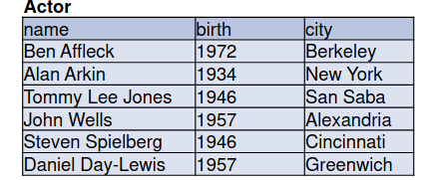
SIMPLE DEPENDENCIES
Assume that no two actors have the same name.
Each actor has a unique date and city of birth
▪ Therefore, given an actor’s name, there is only one possible value for
birth and for city.
• name → birth
• name → city
▪ However, given a birth year, we do not have a unique corresponding
name or city.
• birth ↛ name
• birth ↛ city
▪ Cannot tell from example whether or not city determines name or birth

Slide 15
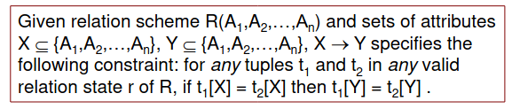
FUNCTIONAL DEPENDENCY
▪ Constraint between two sets of attributes from the database
▪ Property of semantics or meaning of the attributes
▪ Recognized and recorded as part of database design
▪ Given a relation state
• Cannot determine which functional dependencies hold
• Can state that functional dependency does not hold if there are
tuples that show violation of the dependency
▪ Write {B 1 ,B 2 ,…,B i }  {C 1 ,C 2 ,…,C j } but can omit set braces if i=1 or
j=1, respectively.
• {name}  {birth,city}
or
name  {birth,city}

Slide 16
TRANSITIVE DEPENDENCY
Whenever some indirect relationship happens to cause functional dependency (FC), it is known as Transitive Dependency. Thus, if A -> B and B -> C are true, then A -> C happens to be a transitive dependency.
Thus, to achieve 3NF, one must eliminate the Transitive Dependency.
Note:
The given functional dependency can only be transitive when it is formed indirectly by two FDs. For example,
P -> R happens to be a transitive dependency when the following functional dependencies hold true:
P -> Q
Q does not -> P
Q -> R
The transitive dependency can occur easily only in the case of some given relation of three or more attributes. Such a type of dependency helps us in normalizing the database in their 3rd Normal Form (3NF).

Slide 17
TRIVIAL FUNCTIONAL DEPENDENCIES
Some dependencies must always hold
• {birth, date} ->{birth, date}
• {birth, date} ->date
• {birth, date} ->birth
For any relation schema R and subsets of attributes X and Y in R,
if Y-> X, then X->Y.
P -> Q
Q does not -> P
Q -> R
The transitive dependency can occur easily only in the case of some given relation of three or more attributes. Such a type of dependency helps us in normalizing the database in their 3rd Normal Form (3NF).

Slide 18
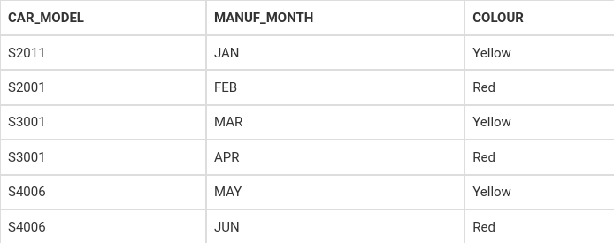
MULTIVALUED DEPENDENCY
• Multivalued dependency would occur whenever two separate attributes in a given table happen to be independent of each other. And yet, both of these depend on another third attribute.
• The multivalued dependency contains at least two of the attributes dependent on the third attribute. This is the reason why it always consists of at least three of the attributes.
In this case, the columns COLOUR and MANUF_MONTH are dependent on CAR_MODEL, and they are independent of each other. Thus, we can call both of these columns multivalued. These are, as a result, dependent on CAR_MODEL. Here is a representation of the dependencies we discussed above:
CAR_MODEL → → MANUF_MONTH
CAR_MODEL → → COLOUR
We can read this as “CAR_MODEL multidetermined MANUF_MONTH” and “CAR_MODEL multidetermined COLOUR”.

Slide 19


JOIN DEPENDENCY
• Join dependency or JD is a constraint that is similar to FD (functional dependency) or MVD (multivalued dependency).
• JD is satisfied only when the concerned relation is a join of a specific number of projections. Thus, such a type of constraint is known as a join dependency.
Our Join Dependency would be:
{(Stu_Name, Stu_Skills ), ( Stu_Name, Stu_Job), (Stu_Skills, Stu_Job)}
The relations given above have join dependency. Thus, they do not happen to be in 5NF. It means that the join relation of the three relations given above is equal to the very original relation <Student>.

Slide 20
ANOTHER LOOK AT KEYS
Assume that EMPLOYEE(EmpNo, FirstName, LastName,
Department, Email, Phone) has keys:
1. EmpNo
2. Email
3. (FirstName, LastName, Department)
▪ Some functional dependencies:
• EmpNo→ {EmpNo ,FirstName, LastName, Department, Email, Phone}
• Email → {EmpNo ,FirstName, LastName, Department, Email, Phone}
• {FirstName, LastName, Department} → {EmpNo ,FirstName, LastName,
Department, Email, Phone}
• {EmpNo, Email, Phone} → {EmpNo ,FirstName, LastName, Department,
Email, Phone},

Slide 21
▪ Given relation scheme R(A1,A2,...,An) and set of attributes X in R.
X is a superkey for R if X  {A1,A2,...,An}.
• Often written as X  R
▪ To determine that X is a key, need to also show that no proper
subset of X determines R
• ∄Y such that Y⊊ X and Y  R

Slide 22
Normalization
Normalization is a process of minimizing redundancy from a relation or set of relations which means organizing the data in database to avoid data redundancy, insertion anomaly, update anomaly & deletion anomaly.
Normalization Avoids
Duplication of Data
Insert Anomaly
Delete Anomaly
Update Anomaly

Slide 23
Example
S_id | Name | Age | Br_code
1 | A | 18 | 101
2 | B | 19 | 101
3 | C | 18 | 101
4 | D | 21 | 102
5 | E | 20 | 102
6 | F | 19 | 103
Br_code | Br_name | Hod_Name
101 | CS | XYZ
102 | EC | PQR
103 | ME | KLM
As one paragraph contains a single idea similarly one table must contain direct and main data about an entity.
Normalization (Decomposition of Tables) of table is done on the basis of functional dependencies.

Slide 24
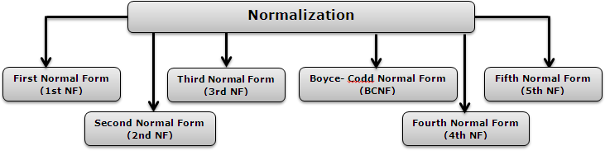
Types of Normalization

Slide 25
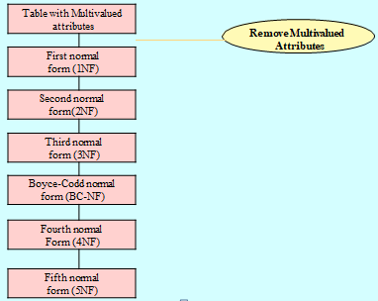
1st Normal Form
As per the rule of first normal form, an attribute (column) of a table cannot hold multiple values. It should hold only atomic values.In simpler words, A relation is said to be in 1 normal form in DBMS (or 1NF) when it consists of an atomic value.

Slide 26
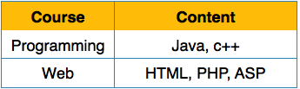
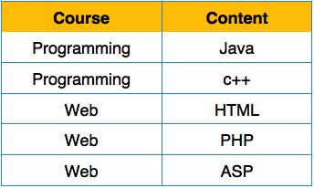
1st Normal Form
Disallows composite attributes, multivalued attributes i.e., attributes whose values for an individual tuple are non-atomic
Considered to be part of the definition of relation
1NF Example
We re-arrange the relation (table) as below, to convert it to First Normal Form

Slide 27
Check Normal form of Table
Not possible in 1st NF because it allow atomic Value. So it is not in INF.
Conversion in I NF
Roll | Name | Course
101 | CS | CN
 |  | OS
102 | EC | DBMS
 |  | CO
Br_code | Br_name | Hod_Name
101 | CS | CN
101 | CS | OS
102 | EC | DBMS
102 | EC | CO

Slide 28
2nd Normal Form
In 2nd NF:
Remove Partial Dependencies.
Functional Dependency: The value of one attribute in a table is determined entirely by the value of another.
Partial Dependency: A type of functional dependency where an attribute is functionally dependent on only part of the primary key (primary key must be a composite key).
Create separate table with the functionally dependent data and the part of the key on which it depends. Tables created at this step will usually contain descriptions of resources.
Definition: A relation is in 2NF when it is in the First Normal Form but has no non-prime attribute functionally dependent on any candidate key's proper subset in a relation.

Slide 29
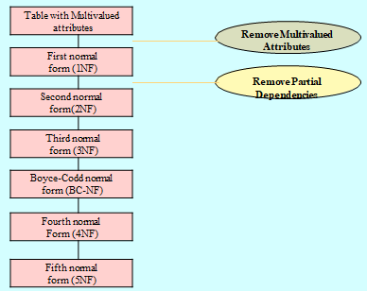

Slide 30
Example: 2nd Normal Form
Example: R ( ABCD)
Where, AB🡪 D and B🡪C
In this Candidate Key, (AB)+ = {ABCD}
Here, Prime attributes: AB
Non prime Attribute: CD
A relation schema R is in second normal form (2NF) if every non-prime attribute A in R is fully functionally dependent on the primary key
R can be decomposed into 2NF relations via the process of 2NF normalization
Dependent on both A and B
Depend only on B, called Partial Dependency

Slide 31
Example: 2nd Normal Form
A | B | C
a | 1 | X
b | 2 | Y
a | 3 | Z
c | 3 | Z
d | 3 | Z
e | 3 | Z
Relation: R (ABC)
Where, B🡪 C
Now, AB+ = {ABC}
So AB is candidate Key
Relation R
Not in 2nd NF, Because C has partial dependency
Relation R1
A | B
a | 1
b | 2
a | 3
c | 3
d | 3
e | 3
Relation R2
B | C
1 | X
2 | Y
3 | Z
R (ABC)
R1 (AB)
R2 (BC)
Now, it is in 2nd NF

Slide 32
3rd Normal Form
A table design is said to be in 3NF if both the following conditions hold:
Table must be in 2NF
Transitive functional dependency of non-prime attribute on any super key should be removed.
An attribute that is not part of any candidate key is known as non-prime attribute.
In other words 3NF can be explained like this: A table is in 3NF if it is in 2NF and for each functional dependency X-> Y at least one of the following conditions hold:
X is a super key of table
Y is a prime attribute of table
An attribute that is a part of one of the candidate keys is known as prime attribute.

Slide 33
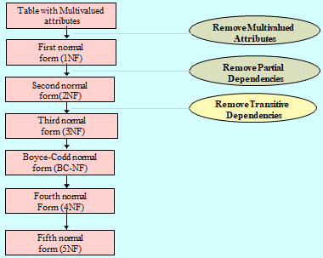

Slide 34

EXAMPLE
Consider this table:
FD set: {STUD_NO -> STUD_NAME, STUD_NO -> STUD_STATE, STUD_STATE -> STUD_COUNTRY, STUD_NO -> STUD_AGE}
Candidate Key: {STUD_NO}
For this relation in table , STUD_NO -> STUD_STATE and STUD_STATE -> STUD_COUNTRY are true. So STUD_COUNTRY is transitively dependent on STUD_NO. It violates the third normal form. To convert it in third normal form, we will decompose the relation STUDENT (STUD_NO, STUD_NAME, STUD_PHONE, STUD_STATE, STUD_COUNTRY_STUD_AGE) as:
STUDENT (STUD_NO, STUD_NAME, STUD_PHONE, STUD_STATE, STUD_AGE) STATE_COUNTRY (STATE, COUNTRY)

Slide 35
Boyce Codd Normal Form
In BCNF:
When a relation has more than one candidate key, anomalies may result even though the relation is in 3NF.
3NF does not deal satisfactorily with the case of a relation with overlapping candidate keys
i.e. composite candidate keys with at least one attribute in common.
BCNF is based on the concept of a determinant.
A determinant is any attribute (simple or composite) on which some other attribute is fully functionally dependent.
A relation is in BCNF is, and only if, every determinant is a candidate key.
Definition: A relation is in Boyce-Codd Normal Form (BCNF) if every determinant is a candidate key. (See the links in the box at right for definitions of determinant and candidate key.)

Slide 36
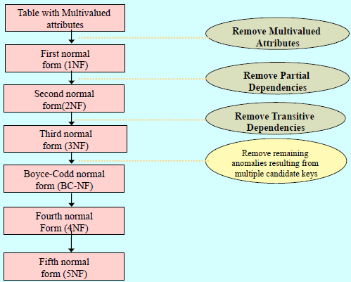
The difference between 3NF and BCNF is that for a functional dependency A 🡪 B, 3NF allows this dependency in a relation if B is a primary-key attribute and A is not a candidate key, Whereas BCNF insists that for this dependency to remain in a relation, A must be a candidate key.

Slide 37
Example:
For example consider relation R(A, B, C)
A -> BC, B -> A
A and B both are super keys so above relation is in BCNF.
Note –
BCNF decomposition may always not possible with dependency preserving, however, it always satisfies lossless join condition. For example, relation R (V, W, X, Y, Z), with functional dependencies:
V, W -> X Y, Z -> X W -> Y
It would not satisfy dependency preserving BCNF decomposition.
Note -:Redundancies are sometimes still present in a BCNF relation as it is not always possible to eliminate them completely.

Slide 38
Practice Question
Given the relation schema R = (A, B, C, D, E) and the canonical cover of its set of functional dependencies
Fc = { A → BC
CD → E
B → D
E → A }
Compute a lossless join decomposition in Boyce-Codd Normal Form for R.

Slide 39
Multi-valued Dependency
Multi-valued dependency occurs when two attributes in a table are independent of each other but, both depend on a third attribute. A multivalued dependency consists of at least two attributes that are dependent on a third attribute that's why it always requires at least three attributes.
Whenever two independent 1:N relationships A:B and A:C are mixed in the same relation, R(A, B, C), an MVD may arise.

Slide 40
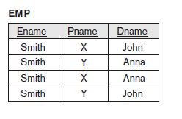
Multi-valued Dependency- Example
The relation EMP is an all-key relation (with key made up of all attributes) and therefore has no f.d.’s and as such qualifies to be a BCNF relation.
We can see that there is an obvious redundancy in the relation EMP—the dependent information is repeated for every project and the project information is repeated for every dependent.
Figure 1

Slide 41

Trivial and Non Trivial MVD
A multivalued dependency in R is called a trivial MVD if
Y is a subset of X or
X U Y = R.
For example, the relation EMP_PROJECTS
has the trivial MVD and
the relation EMP_DEPENDENTS has the trivial
MVD
An MVD that satisfies neither (a) nor (b) is called a nontrivial MVD.

Slide 42
Fourth Normal Form
Definition: A relation schema R is in 4NF with respect to a set of dependencies F (that includes functional dependencies and multivalued dependencies) if, for every nontrivial multivalued dependency X →→ Y in F+, X is a superkey for R.
F+ refers to the cover of functional dependencies F, or all dependencies that are implied by F.
We can state the following points:
An all-key relation is always in BCNF since it has no FDs.
An all-key relation such as the EMP relation in Figure 1, which has no FDs but has the MVD Ename →→ Pname | Dname, is not in 4NF.
A relation that is not in 4NF due to a nontrivial MVD must be decomposed to convert it into a set of relations in 4NF.
The decomposition removes the redundancy caused by the MVD.

Slide 43
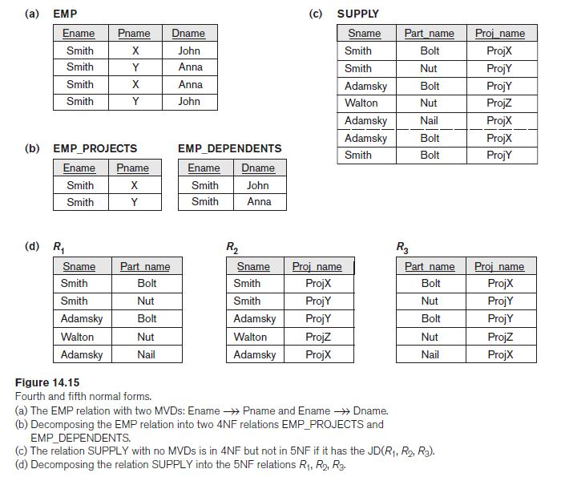
Fourth Normal Form- Example
The process of normalizing a relation involving the nontrivial MVDs that is not in 4NF consists of decomposing it so that each MVD is represented by a separate relation where it becomes a trivial MVD.

Slide 44
Join Dependencies and Fifth Normal Form
In our discussion so far, we have pointed out the problematic functional dependencies and shown how they were eliminated by a process of repeated binary decomposition during the process of normalization to achieve 1NF, 2NF, 3NF, and BCNF. These binary decompositions must obey the NJB (Non-additive Join Test for Binary Decompositions) property.

Slide 45
NJB (Non-additive Join Test for Binary Decompositions)
A decomposition D = {R1, R2} of R has the lossless (nonadditive) join property with respect to a set of functional dependencies F on R if and only if either
The FD ((R1 ∩ R2) → (R1 − R2)) is in F+, or
The FD ((R1 ∩ R2) → (R2 − R1)) is in F+

Slide 46
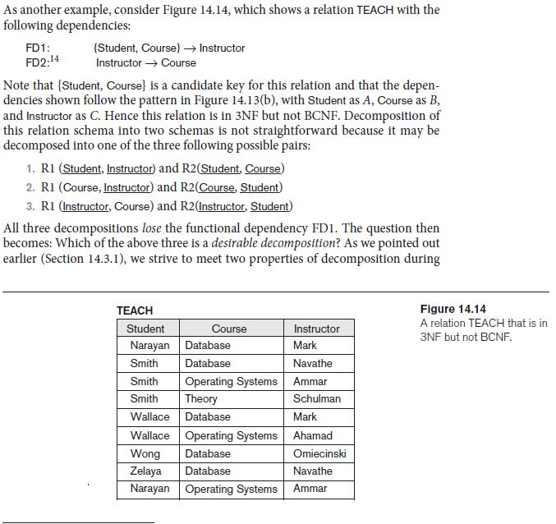
NJB Example
If we apply this test to the above three decompositions, we find that only the third decomposition meets the test. In the third decomposition, the R1 ∩ R2 for the above test is Instructor and R1 − R2 is Course. Because Instructor → Course, the NJB test is satisfied and the decomposition is nonadditive. (It is left as an exercise for the reader to show that the first two decompositions do not meet the NJB test.) Hence, the proper decomposition of TEACH into BCNF relations is:
TEACH1 (Instructor, Course) and TEACH2 (Instructor, Student)

Slide 47
Join Dependency
Definition: A join dependency (JD), denoted by JD(R1, R2, … , Rn), specified on relation schema R, specifies a constraint on the states r of R. The constraint states that every legal state r of R should have a nonadditive join decomposition into R1, R2, … , Rn. Hence, for every such r we have
* (πR1(r), πR2(r), … , πRn(r)) = r

Slide 48
Fifth Normal Form
Definition: A relation schema R is in fifth normal form (5NF) with respect to a set F of functional, multivalued, and join dependencies if, for every nontrivial join dependency JD(R1, R2, … , Rn) in F+ (that is, implied by F), every R_{i} is a superkey of R.

Slide 49
Domain-Key Normal Form (DKNF)
Definition: A relation schema is said to be in DKNF if all constraints and dependencies that should hold on the valid relation states can be enforced simply by enforcing the domain constraints and key constraints on the relation.
The idea is to specify (theoretically, at least) the “ultimate normal form” that takes into account all possible types of dependencies and constraints. .
For a relation in DKNF, it becomes very straightforward to enforce all database constraints by simply checking that each attribute value in a tuple is of the appropriate domain and that every key constraint is enforced.
The practical utility of DKNF is limited .

Slide 50
Question
Suppose there is a company wherein employees work in more than one department. They store the data like this:
Functional dependencies in the table above: emp_id -> emp_nationality emp_dept -> {dept_type, dept_no_of_emp}
Candidate key: {emp_id, emp_dept}
Find Highest Normal Form and Convert it into BCNF.
emp_id | emp_nationality | emp_dept | dept_type | dept_no_of_emp
1001 | Austrian | Production and planning | D001 | 200
1001 | Austrian | stores | D001 | 250
1002 | American | design and technical support | D134 | 100
1002 | American | Purchasing department | D134 | 600

Slide 51
Answer
The table is not in BCNF as neither emp_id nor emp_dept alone are keys. To make the table comply with BCNF we can break the table in three tables like this:
emp_nationality table:
emp_dept table:
emp_id | emp_nationality
1001 | Austrian
1002 | American
emp_dept | dept_type | dept_no_of_emp
Production and planning | D001 | 200
stores | D001 | 250
design and technical support | D134 | 100
Purchasing department | D134 | 600

Slide 52
Answer
emp_dept_mapping table:
Functional dependencies: emp_id -> emp_nationality emp_dept -> {dept_type, dept_no_of_emp}
Candidate keys: For first table: emp_id For second table: emp_dept For third table: {emp_id, emp_dept}
This is now in BCNF as in both the functional dependencies left side part is a key.
emp_id | emp_dept
1001 | Production and planning
1001 | stores
1002 | design and technical support
1002 | Purchasing department

Slide 53
Practice Question
Let consider Schema R = ABCD, F = {A -> B, B -> C, AC -> D}. Find Normal Form and convert it into 3rd NF.
Solution: Candidate key: {A}
Step 1: nothing
Step 2: Minimal F’ = {A -> B, B -> C, A -> D}
Step 3: create relations:
For A->B, create a relation R1(A,B)
For B->C, create a relation R2(B,C)
For A->D, create a relation R3(A,D)
Step 4: do nothing
Step 5: do nothing, since candidate key A is in A->B
Result: R1(A,B), R2(B,C), R3(A,D

Slide 54
Interview Questions
1:What is Primary key and uses?
2. Use of foreign key ?
3. Different types of keys ?
4 Different keys used in DBMS? With explanation?
5. What is the difference between primary key and foreign key?

Slide 55
References
Data Base Management System by Navathe
Data Base Management System by C J date
Data Base Management System by Korth
https://docs.microsoft.com/en-us/office/troubleshoot/access/database-normalization-description
https://www.studytonight.com/dbms/database-key.php
https://www.javatpoint.com/dbms-keys

Slide 56
Thank you
‹#›

